Slide 1

Department of Computer Science, CUI Lahore Campus
Formal Methods in Software Engineering
By
Farooq Ahmad

Slide 2
Sets in Z
Sets as types, declaring variables and set variables

Slide 3
Topics to be discussed
Sets as types
Declaring variables
Declaring set variables
Set operators

Slide 4
Sets
A set is an unordered well-defined collection of objects in which repetition is not significant.
Well-defined' means that given a value, it is possible to decide whether it is a member of the set.
The members of a set are distinct values, that is to say there is no notion of how many times a value occurs in a set; either it is there or it is not.
The members of a set are not considered to be in any particular order.

Slide 5
Sets for system modeling
To formalize the notion 'of the same kind or unique' we introduce into a Z specification certain sets called types.
So, if we are modelling a collection of objects that are considered unique, and in which ordering is unimportant, the set type is a good candidate.
Example: consider a collection of patients registered on the books of a doctor’s surgery. A set might be used to model this collection, as patients are considered unique in the register and the ordering of patients in this register will not be relevant.

Slide 6
Where sets are not suitable
If repetition and ordering are relevant, however, a set may not be an appropriate type to use.
Example: a set would not be the appropriate way to model the queue of patients waiting for a doctor, as ordering is important here.
Also, a set may not be an appropriate way to model the patients seen by a doctor over a given period, as a patient may have seen a doctor more than once.

Slide 7
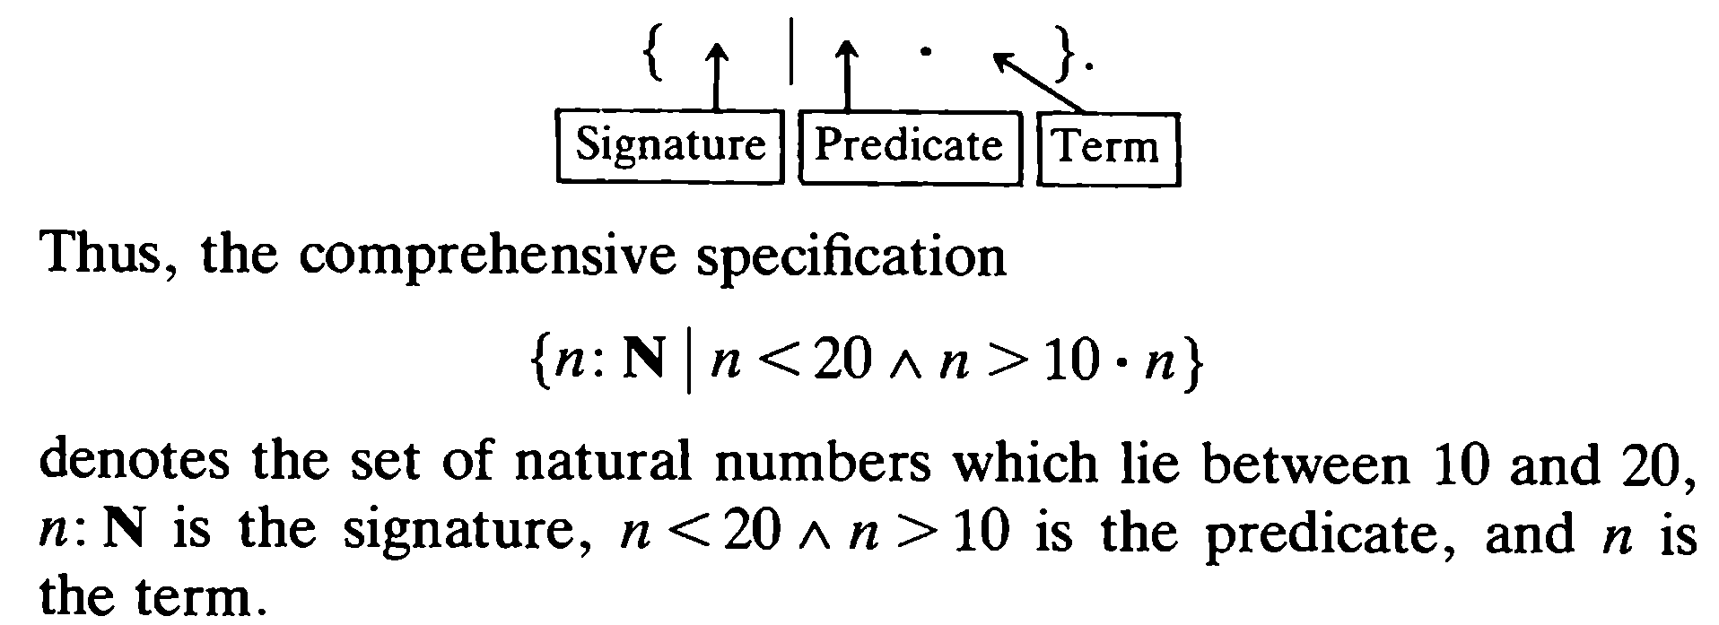
Comprehensive specification
Suppose D denotes some declarations, P a predicate constraining the values and E an expression denoting a term; then an expression of the form {D | P • E}

Slide 8
The predicate part
The predicate part of a comprehensive set specification defines the properties of the members of the set which is specified.
Thus, {n:N|n³>10 ●n} specifies the set of natural numbers which have the property that their cubes are greater than 10.

Slide 9
The term part
The term part of a comprehensive set specification defines the form of the members of the set. A term consists of an expression which, when evaluated, will deliver a value which is of the same type as the set. For example,
{n:N|n >20 ^ n<100 ●n} states that a set will contain single natural numbers which satisfy n >20 ^ n<100
{x, y:N|x+y = 100 ● (x, y)}
specifies the set of pairs which are natural numbers whose sum is 100. i.e. {(0,100), (1,99), (2,98),. . . , (100, 0)}. Thus, the term in this example defines the fact that elements of the set are pairs.
{x, y:N|x+y = 5 ● x² + y²} is the set of natural numbers of the form x2 + y2 where x + y equals 5. This specifies the set {13, 17, 25}.

Slide 10
Types in library management systems
The decision about which sets are to be types is part of the specification process.
Book is the type from which the books in the library are drawn.
Person is a set from which the borrowers are drawn, and it will be a type of the specification.
In the library management system, the types Book and Person should be introduced as given sets:
[Book], [Person] OR
[Book, Person]

Slide 11
Declaration of variables
if [Student] is a type, we can declare a variable for a student oneStudt with the following declaration:
oneStudt: Student
Note that the variable name being declared is followed by a colon, and then by the name of the set from which it takes its values.
A possible value of declared variable:
oneStudt = Ali

Slide 12
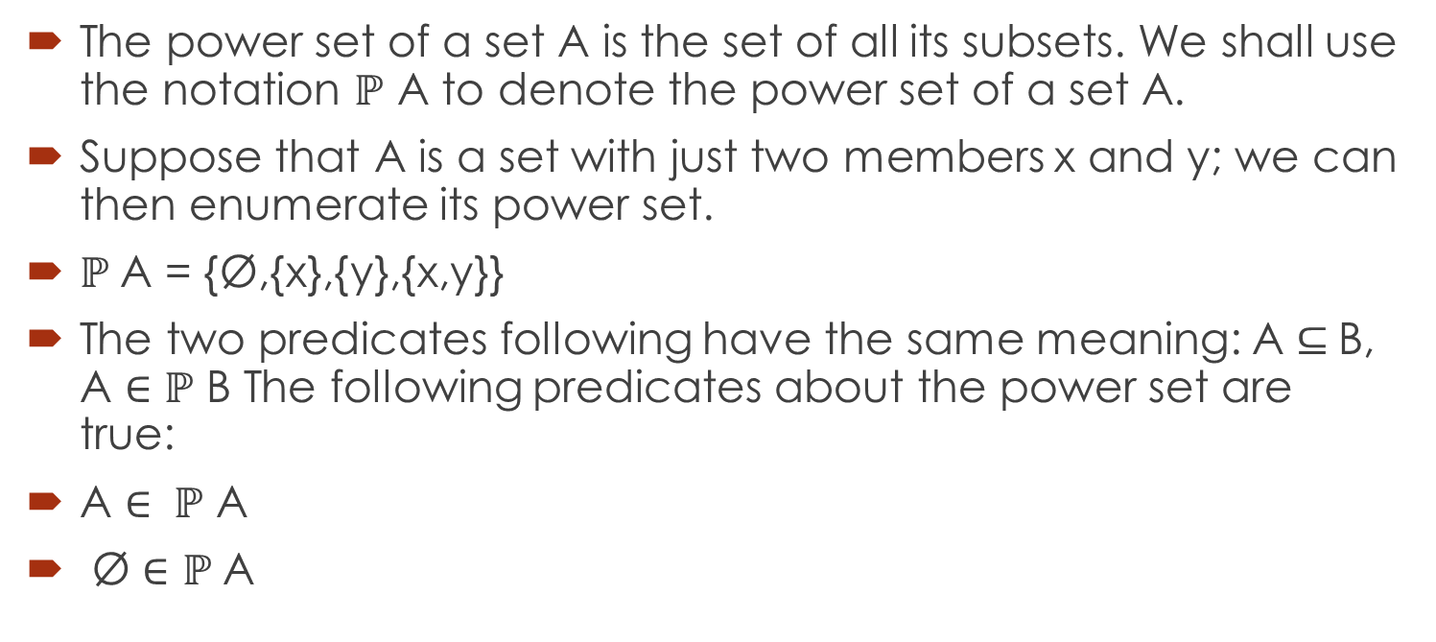
Power set
The power set of a set A is the set of all its subsets. We shall use the notation $ℙ$ A to denote the power set of a set A.
Suppose that A is a set with just two members x and y; we can then enumerate its power set.
$ℙ$A = {Ø,{x},{y},{x,y}}
The two predicates following have the same meaning: A $⊆$B, A $∈ℙ$ B The following predicates about the power set are true:
A $∈ ℙ$ A
Ø $∈$ $ℙ$A

Slide 13
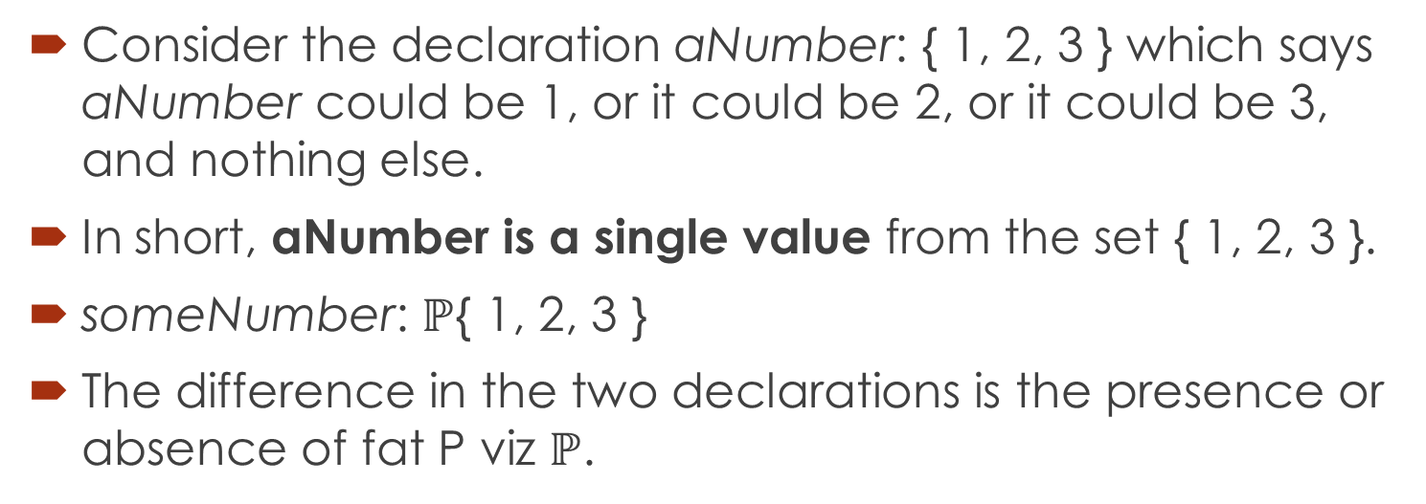
Set variable and single valued variable
Consider the declaration aNumber: { 1, 2, 3 } which says aNumber could be 1, or it could be 2, or it could be 3, and nothing else.
In short, aNumber is a single value from the set { 1, 2, 3 }.
someNumber: $ℙ${ 1, 2, 3 }
The difference in the two declarations is the presence or absence of fat P viz $ℙ$.

Slide 14
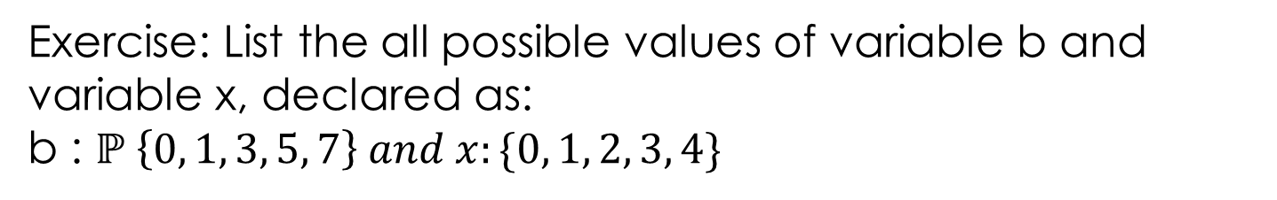
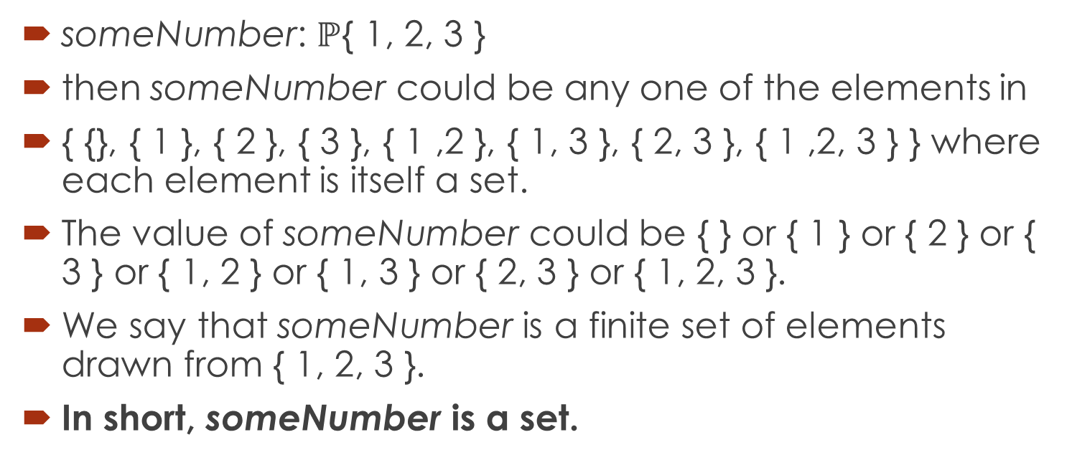
Declaring set variable
someNumber: $ℙ${ 1, 2, 3 }
then someNumber could be any one of the elements in
{ {}, { 1 }, { 2 }, { 3 }, { 1 ,2 }, { 1, 3 }, { 2, 3 }, { 1 ,2, 3 } } where each element is itself a set.
The value of someNumber could be { } or { 1 } or { 2 } or { 3 } or { 1, 2 } or { 1, 3 } or { 2, 3 } or { 1, 2, 3 }.
We say that someNumber is a finite set of elements drawn from { 1, 2, 3 }.
In short, someNumber is a set.
Exercise: List the all possible values of variable b and variable x, declared as:
b : $ℙ \left\{0, 1, 3, 5, 7\right\} and x:\{0, 1, 2, 3, 4\}$

Slide 15
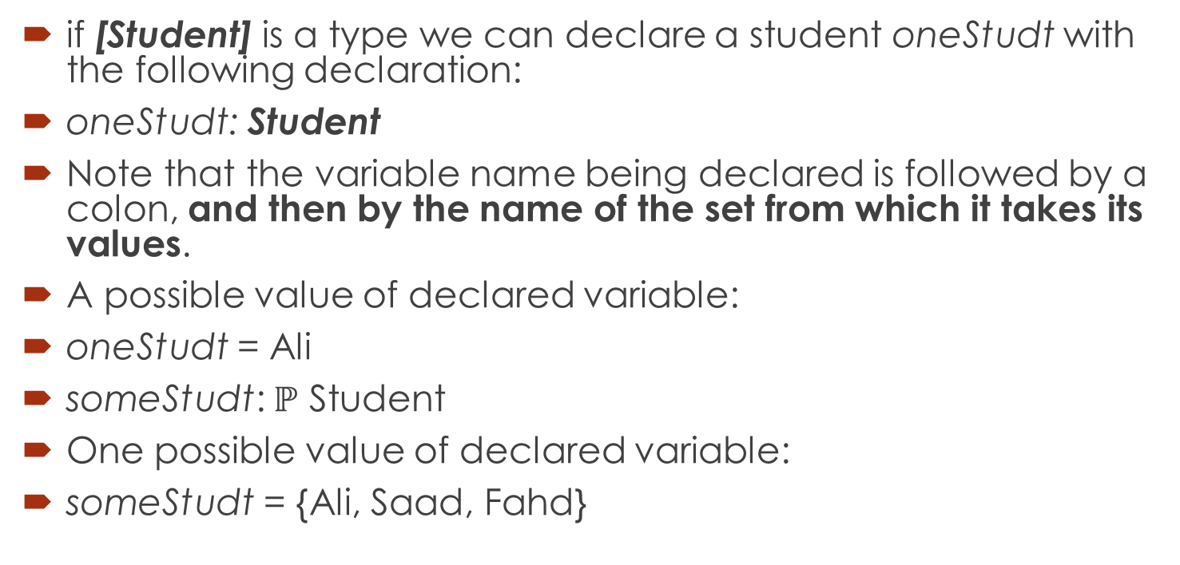
Declaring set variables
if [Student] is a type we can declare a student oneStudt with the following declaration:
oneStudt: Student
Note that the variable name being declared is followed by a colon, and then by the name of the set from which it takes its values.
A possible value of declared variable:
oneStudt = Ali
someStudt: $ℙ$ Student
One possible value of declared variable:
someStudt = {Ali, Saad, Fahd}

Slide 16
Some more sets for library system
Book; is the set of books owned by the library. All the members of books are of the same type, being drawn from the set Book.
On_loan; is the set of books that have been borrowed. All the members of on_loan are drawn from the set Book.
On_shelves; is the set of books that have not been borrowed, and are still believed to be on the library shelves. All the members of on_shelves are drawn from the set Book.
Reference; is the set of books that may never be borrowed, but are to be used only on the library premises. All the members of reference are drawn from the set Book.
Borrowers; is the set of people who are entitled to borrow books from the library. All the members of borrowers are drawn from the set Person.

Slide 17
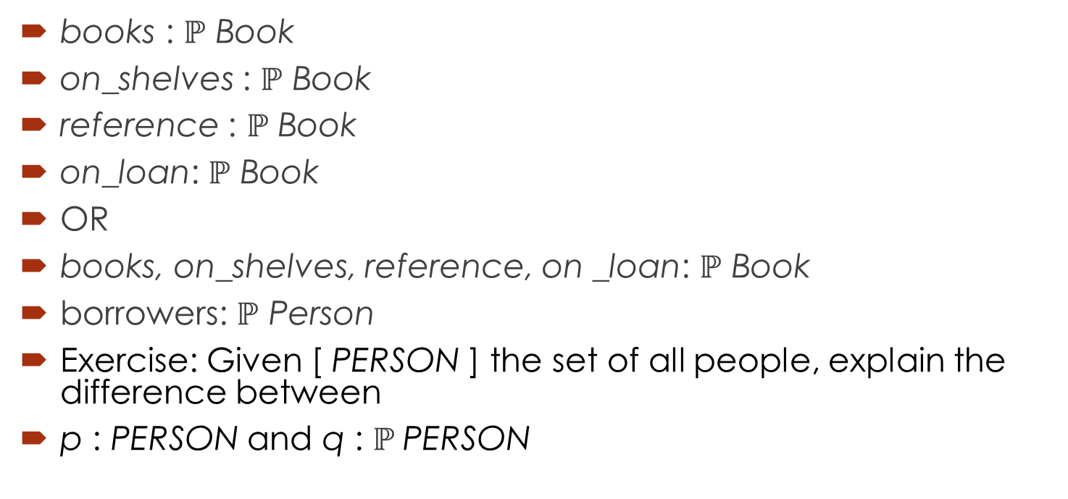
Declaring set variables for Library Management system
books : $ℙ$ Book
on_shelves : $ℙ$ Book
reference : $ℙ$ Book
on_loan: $ℙ$ Book
OR
books, on_shelves, reference, on _loan: $ℙ$ Book
borrowers: $ℙ$ Person
Exercise: Given [ PERSON ] the set of all people, explain the difference between
p : PERSON and q : $ℙ$PERSON

Slide 18
Exercise
A hotel system reserves rooms for guests from an arrival date to a departure date. Types here could include:
HOTEL - the set of all hotels
RESERVATION - the set of all reservations
ROOM - the set of all rooms
GUEST - the set of all guests
DATE - the set of all dates
Declare and explain variables to represent:
A) a single hotel
B) a finite set of rooms
C) a single reservation
D) a finite set of guests
E) a single date.

Slide 19
Enumerated types
Sometimes we wish to introduce a type with a small number of members, and give names to the members of the type.
YesNo :: = yes | no
The sign ':: = ' is the data type definition symbol, and the sign '|' is the branch separator.
Day ::=MON | TUE| WED | THU| FRI| SAT | SUN
aDay: Day

Slide 20
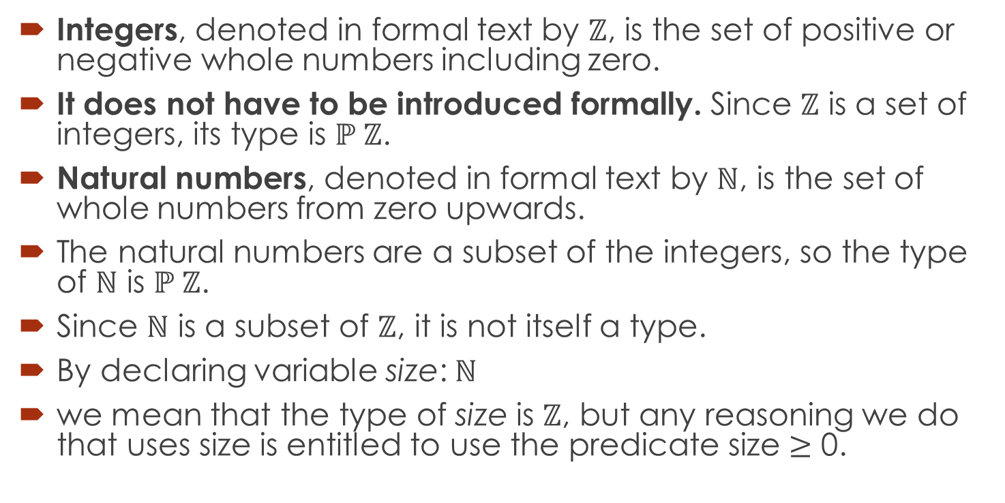
Sets of numbers
Integers, denoted in formal text by $ℤ$, is the set of positive or negative whole numbers including zero.
It does not have to be introduced formally. Since $ℤ$ is a set of integers, its type is $ℙ ℤ$.
Natural numbers, denoted in formal text by $ℕ$, is the set of whole numbers from zero upwards.
The natural numbers are a subset of the integers, so the type of $ℕ$ is $ℙ ℤ$.
Since $ℕ$ is a subset of $ℤ$, it is not itself a type.
By declaring variable size: $ℕ$
we mean that the type of size is $ℤ$, but any reasoning we do that uses size is entitled to use the predicate size $≥$ 0.

Slide 21
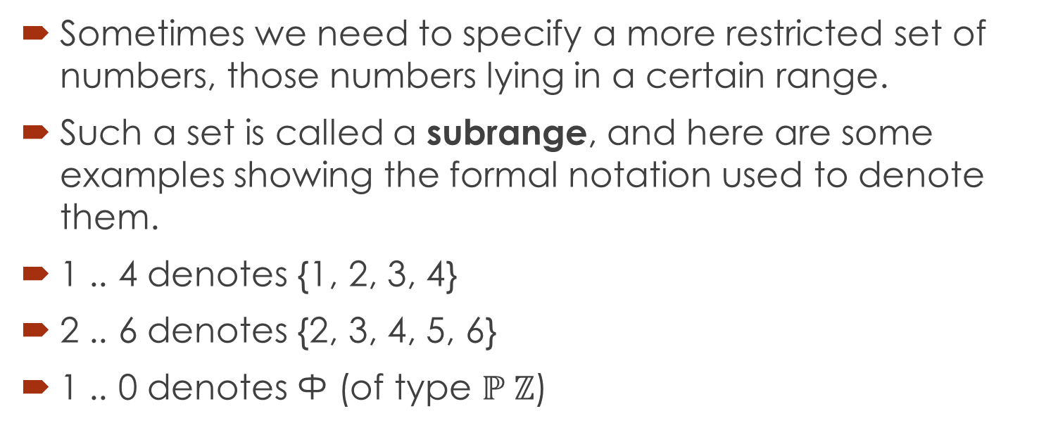
Subrange
Sometimes we need to specify a more restricted set of numbers, those numbers lying in a certain range.
Such a set is called a subrange, and here are some examples showing the formal notation used to denote them.
1 .. 4 denotes {1, 2, 3, 4}
2 .. 6 denotes {2, 3, 4, 5, 6}
1 .. 0 denotes Ф (of type $ℙ ℤ$)

Slide 22
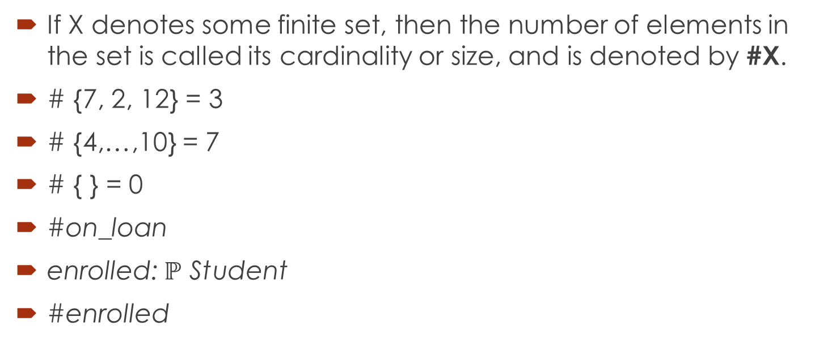
Cardinality of a set
If X denotes some finite set, then the number of elements in the set is called its cardinality or size, and is denoted by #X.
# {7, 2, 12} = 3
# {4,…,10} = 7
# { } = 0
#on_loan
enrolled: $ℙ$ Student
#enrolled

Slide 23
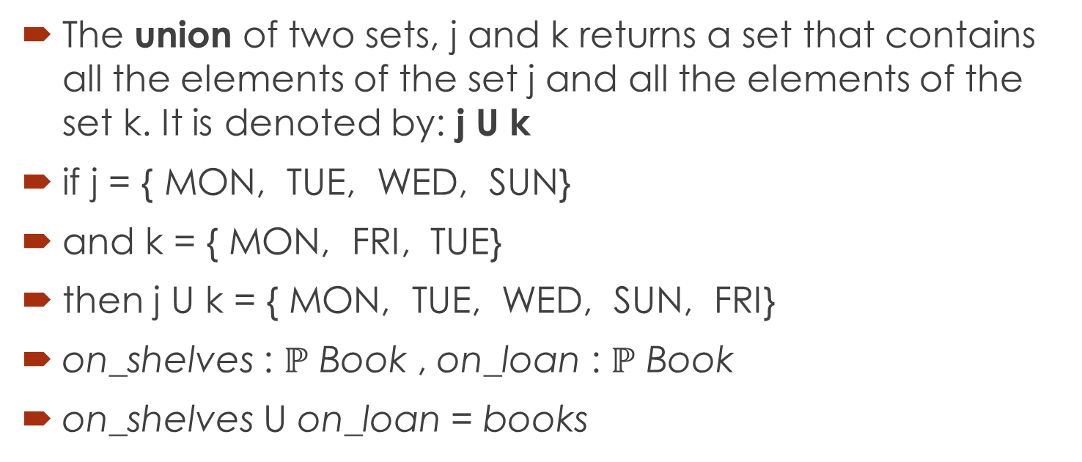
Set Operators: Union
The union of two sets, j and k returns a set that contains all the elements of the set j and all the elements of the set k. It is denoted by: j U k
if j = {MON, TUE, WED, SUN}
and k = {MON, FRI, TUE}
then j U k = {MON, TUE, WED, SUN, FRI}
on_shelves : $ℙ$ Book , on_loan : $ℙ$ Book
on_shelves U on_loan = books

Slide 24
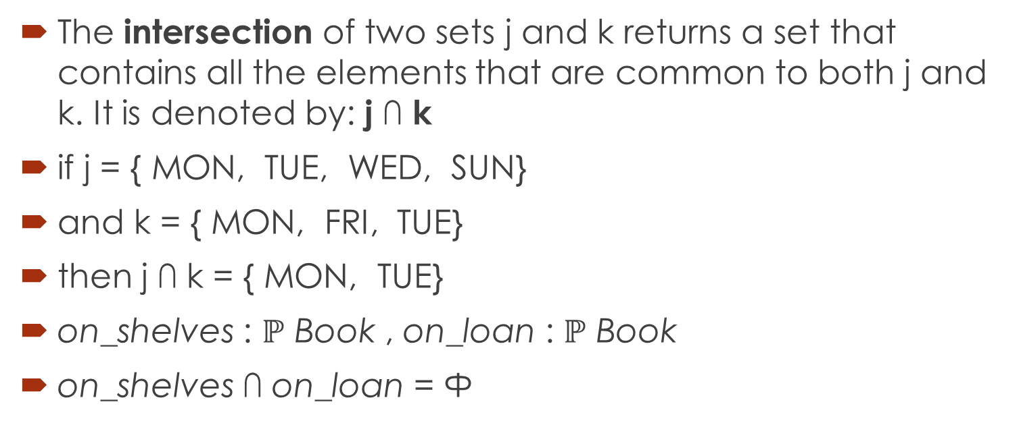
Set Operators: Intersection
The intersection of two sets j and k returns a set that contains all the elements that are common to both j and k. It is denoted by: j ∩ k
if j = {MON, TUE, WED, SUN}
and k = {MON, FRI, TUE}
then j ∩ k = {MON, TUE}
on_shelves : $ℙ$ Book , on_loan : $ℙ$ Book
on_shelves ∩ on_loan = Ф

Slide 25
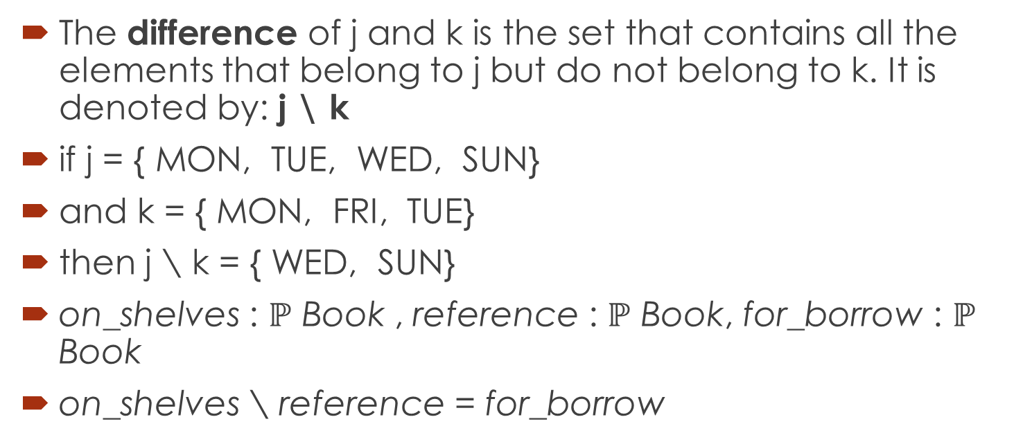
Set Operators: Difference
The difference of j and k is the set that contains all the elements that belong to j but do not belong to k. It is denoted by: j \ k
if j = {MON, TUE, WED, SUN}
and k = {MON, FRI, TUE}
then j \ k = {WED, SUN}
on_shelves : $ℙ$ Book , reference : $ℙ$ Book, for_borrow : $ℙ$ Book
on_shelves \ reference = for_borrow

Slide 26
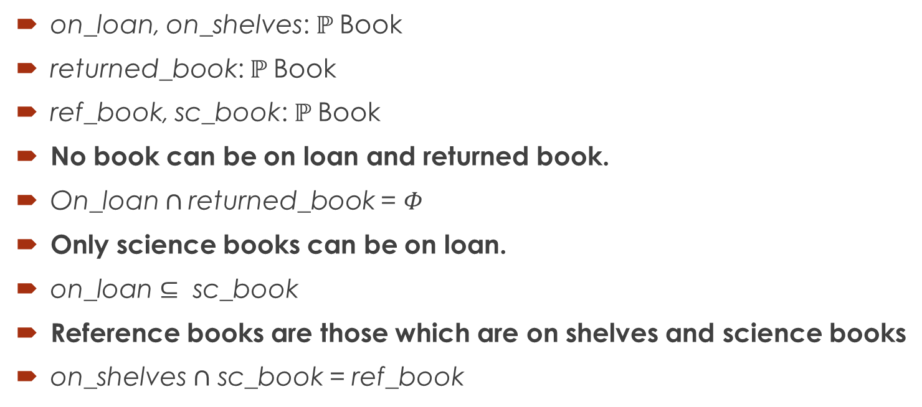
Predicates using set variables
on_loan, on_shelves: $ℙ$Book
returned_book: $ℙ$Book
ref_book, sc_book: $ℙ$Book
No book can be on loan and returned book.
On_loan $∩$returned_book = $Φ$
Only science books can be on loan.
$\text{on}\text{_}\text{loan}⊆$ sc_book
Reference books are those which are on shelves and science books
on_shelves $∩$ sc_book = ref_book

Slide 27
Summary of the lecture: conclusion
Set as data type
Declaring set variables
Operators for set variables
Constructing predicates using set variables

Slide 28
Reference and reading material
Chapter # 3: Section 3.1 of the book “Software development with Z” by J.B. Wordsworth

